Slide 1
IoT Light Sensor Dashboard
Sprint 1 – Product & Deployment Update
Presented by Product owner and Design team

Slide 2
Sprint #1: Light Status Visualization
Validate how light status will be displayed to users using mock data.

Slide 3
What we are demoing today
Room light status visualization
Brightness and ON/OFF state using mock data
Dashboard UI layout (early version)
Completed: #15 #16 #17 #19 #20

Slide 4
Progress:
Dashboard UI is functional with mock light data
Light ON/OFF status and brightness are displayed correctly
Static dashboard is hosted and accessible for demo

Slide 5
Planned:
Integrate real or simulated backend sensor data
Connect the dashboard to APIs or live data endpoints
Improve UI based on feedback from the Sprint 1 demo

Slide 6
Blocked:
Backend and sensor data integration depends on coordination with other teams
Delays in task ownership and communication between teams

Slide 7
Live demo
https://gatraj.github.io/Demo-IOT-lightSensor./

Slide 8
From Sprint 1
From Sprint 1, we learned that validating the UI early is important before connecting live data.
Backend integration will be addressed once the code is fully tested and stable.

Slide 9
Sprint #2
In Sprint 2, our focus will be on:
Integrating the dashboard with backend APIs
Replacing mock data with live sensor data
Deploying the fully functional dashboard

Slide 10
Sprint #2: Features
User Requirements :
Users don’t know if lights are left on
Wasted energy = higher bills
Features:
Measure lux
Track energy consumption
Detect on/off duration
Remote dim/on/off control
Notes:
Problem that the user faces is that they don’t know if lights are left on. Which means wasted energy = higher bills.
Therefore the main features that should be implemented when building this sensor system is
Some classmates suggested additional: Automated schedules and Remote control - Check/control lights away from home
Also some hardware requirements:
Do we only detect state, or also control it?
Battery-powered or wall-powered?
Wi-Fi, Bluetooth, or local-only?
Accuracy? ±5% or ±20% okay?
Safety?

Slide 11
Sprint #2: Light Sensors
Option A — Simple LDR / photoresistor
Pros:
easy analog read
good for just “on/off” detection
Cons:
poor accuracy
nonlinear
temperature sensitive
not true lux measurement
Use when:
“just detect if light is on”
Option B — Photodiode / phototransistor
Pros:
faster
more linear than LDR
Cons:
still needs calibration
not directly lux
more analog design work
Use when:
mid accuracy, custom circuit OK
Option C — Digital ambient light sensor IC
Pros:
outputs lux directly
calibrated
I²C digital
low noise
tiny
super easy firmware
production friendly
Cons:
slightly more expensive
Use when: real product, accurate measurements, minimal headaches
Notes:
Option A — Simple LDR / photoresistor
Pros:
cheap
easy analog read
good for just “on/off” detection
Cons:
poor accuracy
nonlinear
temperature sensitive
not true lux measurement
Use when:
👉 “just detect if light is on”
Option B — Photodiode / phototransistor
Pros:
faster
more linear than LDR
still cheap
Cons:
still needs calibration
not directly lux
more analog design work
Use when:
👉 mid accuracy, custom circuit OK

Slide 12
Sprint #2: Light Sensor Candidates
Sensor | Type | Output | True Lux? | Accuracy | Interface Complexity | Speed | Cost | Pros | Cons
TEMT6000 | Phototransistor | Analog voltage | Approx only | Medium | ADC required | Fast | $ | Simple, cheap, easy | Needs calibration, nonlinear, noisy
Grove Light v1.2 (LDR) | Photoresistor | Analog resistance | No | Low | ADC required | Slow | $ | Very cheap, plug & play | Temp drift, slow response, poor precision
3-Channel Phototransistor Module | Multiple phototransistors | Analog (3x) | No | Medium | ADC ×3 channels | Very fast | $$$ (~$20) | Directional sensing, fast | Overkill, complex wiring, not lux
BH1750 ⭐ | Digital ambient light IC | I²C (lux) | Yes | Good | Very easy | Medium | $ | Direct lux output, cheap, popular, low code | Smaller dynamic range
OPT3001 ⭐⭐ | Precision digital ALS | I²C (lux) | Yes | Very high | Very easy | Medium | $$ | Industry grade, wide range, calibrated | Slightly pricier
VEML7700 ⭐⭐ | Digital ambient light IC | I²C (lux) | Yes | Very high | Very easy | Medium | $$ | Excellent low-light performance, stable, low power | Slightly pricier
Notes:
We’ll compare them based on accuracy, true lux capability, cost, reliability for a product
Analog light sensors (LDR, phototransistor, TEMT6000) provide only relative brightness and require calibration. Digital I²C ambient light sensors (BH1750, OPT3001, VEML7700) provide calibrated lux readings, simpler firmware, and higher reliability. Therefore, we recommend selecting a digital I²C lux sensor for this system.
Why Digital Lux Sensors Are Best Used For IoT…
→ Provide calibrated, noise-resistant digital measurements
→ Scale reliably across many devices
→ Simplifies integration, maintenance, and long-term operation.
the DevOps team recommends adopting the STEMMA QT / Qwiic (I2C) ecosystem. This allows for a 100% no-solder build, reducing physical hardware bugs
Notes
STEMMA QT (Adafruit) and Qwiic (SparkFun) are interchangeable, plug-and-play connection systems using 4-pin JST SH (1mm pitch) connectors for I2C devices

Slide 13
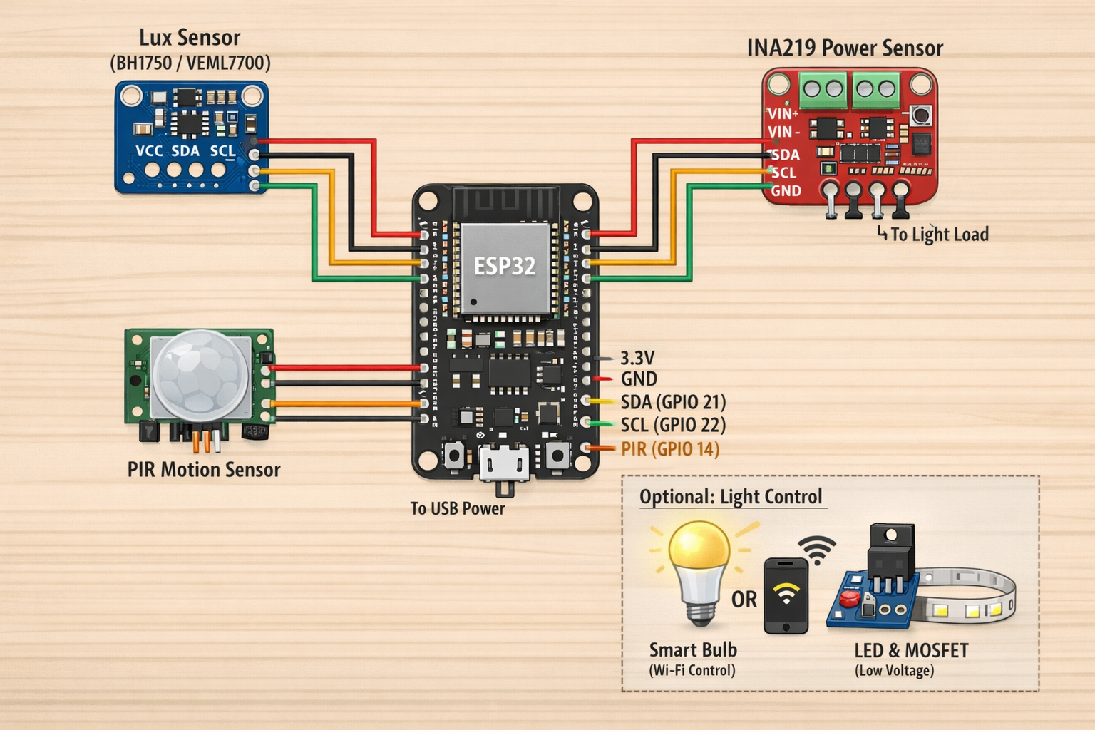
Sprint #2: Hardware Design
Notes:
Circuit Diagram
1. Microcontroller — ESP32 vs Raspberry Pi Pico W:
We evaluated both the Raspberry Pi Pico W and the ESP32 as our main controller. Our device needs to read multiple sensors at the same time, manage Wi-Fi communication, handle encryption, and potentially control lights in real time. So we needed something that’s more than just a basic microcontroller. The Pico W is simpler and cheaper, but it has less memory, fewer built-in security features, and is more limited for multitasking. It’s better for small single-purpose projects.
The ESP32 gives us dual-core processing, so one core can handle sensor timing while the other handles networking. It also has built-in Wi-Fi and Bluetooth, hardware encryption, and significantly more RAM, which makes it better suited for a connected IoT system like ours.
Programming: Supports CircuitPython. The board acts as a USB drive; code is updated by dragging a code.py file onto the device. For a backend or DevOps developer, it handles Wi-Fi and JSON requests exactly like a standard Python script.
So overall, ESP32 gives us better performance, better security, and easier integration — which makes
The ESP32 timestamp readings in NTP( Network Time Protocol) synchronizes computer system clocks to within milliseconds of Coordinated Universal Time (UTC)
that will have to be coded to UTC, and send structured JSON via HTTPS every second. You don’t have to interact with hardware — you just need WIFI to receive standardized API data.
2. Light Sensor — VEML7700 / BH1750 they are digital lux sensors so I²C (easy wiring) and High accuracy
3. Energy Consumption — INA219/INA226: Measures current + voltage + power
✅ Digital I²C
✅ Built-in math (gives watts directly)
✅ Safe low-voltage sensing
The INA219 is low-voltage only. That’s why, in a sprint/prototype, you use DC-powered lights (like LED strips) or a smart bulb. Most smart bulbs are designed for 120V/230V AC mains power but convert it internally to low-voltage DC to run the LED diodes and Wi-Fi components.
4. Motion Sensor — PIR: radar sensor were suggested and they are nice b/c detect micro-movements (like breathing) and works through thin walls but there are also lots of false positives and uses lots of power. PIR sensors provide reliable, low-power presence detection with minimal false positives and simple digital integration
5. Smart Bulb (for sprint): Some had suggested using Traic but you would be introducing high-voltage hardware
✅ zero wiring
✅ safe
✅ fast to test app control
✅ immediate Wi-Fi control
✅ lets team focus on sensing + software
Goal is to test quickly, find challenges with a basic plug-and-play digital sensors Once the sensing and control are solid, then we can add the triac dimmer. It’s safer and lets us move quicker this sprint.

Slide 14
Sprint #2: Hardware Purchase
Online retailers: Amazon, SparkFun, and Adafruit
  Adafruit (NY-based): Trustpilot Score 2.6/5 (Note: primarily due to return policies; hardware is top-tier). Shipping via UPS Ground typically takes 3–5 business days.
  SparkFun (CO-based): Trustpilot Score 4.7/5. Ground shipping typically takes 3–5 business days.
Cost Breakdown: IoT Light Sensor

